Slide 1
PROOF THEORY AS AN IDEAL MODEL OF ARGUMENTATION
Zhdanov Daniil
DA-91

Slide 2
COMPLETE AND PARTIAL SUBSTANTIATED STATEMENT
The proof of the statement is the complete justification of the statement about the truth of any statement.
Refutation is a complete substantiation of the statement about the falsity of any statement..
A confirmation is called a partial justification of a statement about the truth of a statement..
Criticism is a partial justification for the statement that the statement is false.
Partial justification means - the truth of the statement is confirmed with varying degrees of probability

Slide 3
RELATIONSHIP BETWEEN EVIDENCE AND ARGUMENTATION, DISCLAIMER AND CRITICISM:
Argumentation
Critic
Proof
Refutation

Slide 4
STRUCTURE OF THE EVIDENCE:
Evidence
Thesis
Demonstration
Arguments

Slide 5
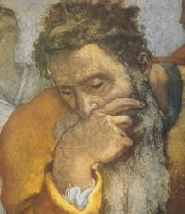
Thesis
It's always a plausible judgment, truth (or falsity) which has yet to be substantiated.

Slide 6
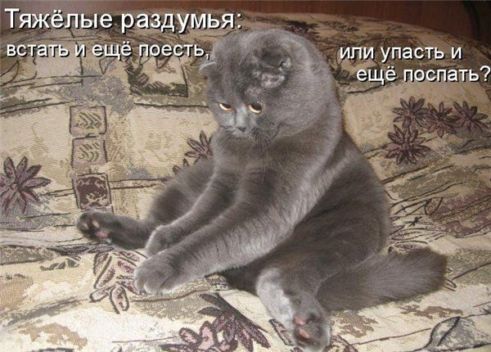
Arguments
Statements, the truth of which is beyond doubt:
Reasonable empirical generalizations
Statements that are true by definition
3) Axioms of meaningful theory
4) Theorems already proved earlier.
5) Statements based on laws, legal norms, presumptions, principles, moral norms.

Slide 7

Demonstration
As a demonstration, the laws of logic and the rules of inference are used.
Full induction - the conclusion is made based on the study of each element of a certain class of phenomena;
A strict analogy - the connection between the basis of the analogy and the transferred attribute is essential, necessary.

Slide 8

TYPES OF EVIDENCE
Direct proof is evidence in which the truth of a thesis is inferred from the truth of the arguments directly, i.e. without introducing additional assumptions.
Any criminal offense is punishable. Bribery is a felony.
______________________________________
Bribery is punishable.

Slide 9
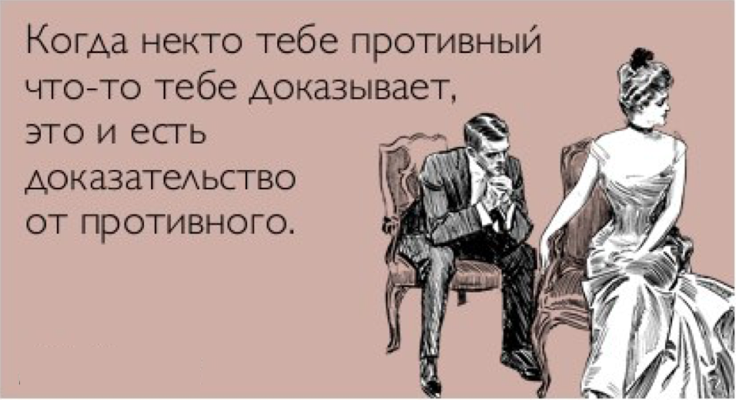
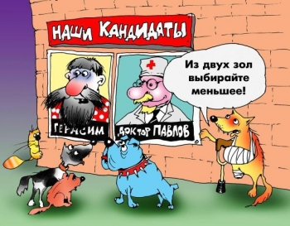
TYPES OF EVIDENCE
Indirect evidence is evidence that is carried out by refuting some other statements. Such statements are additional judgments that are incompatible with the thesis.
"By contradiction" (apagogic)
Types:
Separating (by excluding alternatives)

Slide 10
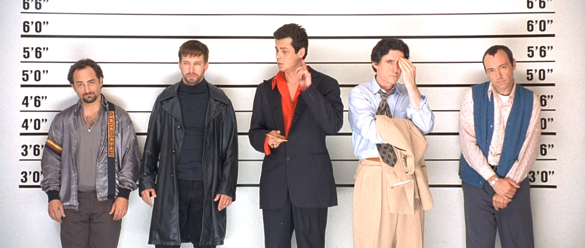
TYPES OF EVIDENCE: EXAMPLES
"By contradiction" (apagogic)
1) Let's say that Smith is not involved in the crime. 2) Smith or Jones was involved in the crime (this is an established fact). From assumption (1) and premise (2) it follows: 3) Jones is involved in a crime. From (3) and another established fact 4) If Jones is involved in a crime, then Brown is involved. The saying follows: 5) Brown is involved in a crime. However, the investigation found out that 6) Brown is not involved in the crime. 7) Smith is involved in a crime
A bank robbery was committed in one city. Suspicion fell on the notorious repeat offenders Smith, Jones and Brown. During the investigation, it turned out that Jones never goes to business without Brown. At least one of the repeat offenders - Smith or Jones - is involved in the crime. Brown has a solid alibi. The investigating police officer charged Smith with this information.

Slide 11
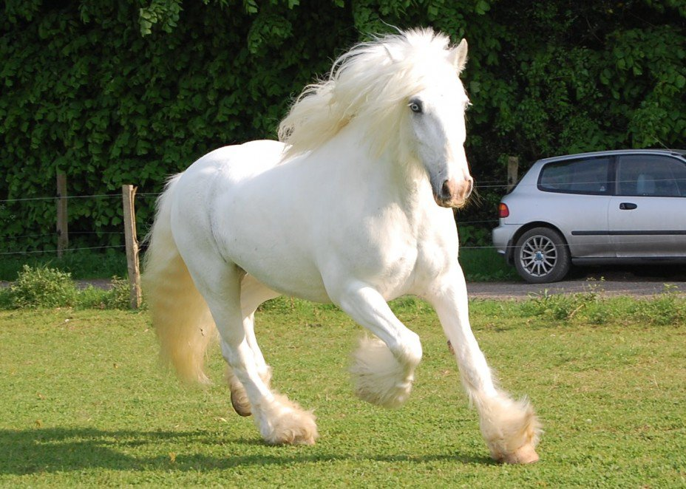
TYPES OF EVIDENCE: EXAMPLES
Separating (by excluding alternatives).
On the eve of the races, the favorite, the best horse in England, the Silver trotter, disappeared and his trainer Straker was killed.
Sherlock Holmes puts forward and considers four versions: A - Silver stayed in the field; B - He returned to the stable; S - He is in the stable of a competitor; D - It was stolen by the gypsies. Going through these alternatives, he consistently rejects three of them as untenable and comes to the conclusion that the horse must be sought from a competitor. Which, in the end, leads him to a successful investigation of the crime as a whole. Holmes' reasoning can be represented by the formula :
( ( А V B V C V D, ¬A, ¬B, ¬D) → C).

Slide 12

METHODS OF DISCLAIMER
1) refutation of the thesis - justification of the falsity of the thesis. This can be done either by direct proof of the antithesis, or by means of the method of "reduction to absurdity". 2) refutation of arguments is reasoning that establishes the groundlessness of the thesis by proving the falsity of the arguments used. 3) refutation of demonstration - detection of logical errors in the form of proof (demonstration), which leads to the assertion of the groundlessness of the thesis.

Slide 13
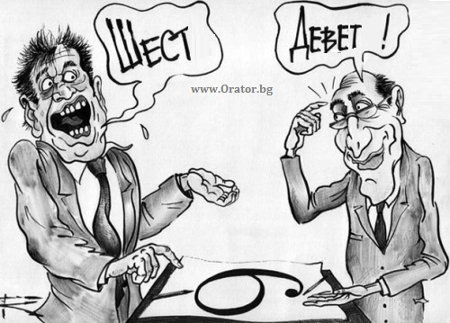
RULES OF EVIDENCE
Rules in relation to the thesis:
The rule of clarity - the thesis must be formulated precisely, clearly, unambiguously.
The rule of constancy - the thesis should remain the same throughout the whole process of proof; it should not be changed, at least not without special reservations.

Slide 14
RULES OF EVIDENCE
Argument rules
Truth rule - arguments must be true judgments since they are the foundation of the whole proof (the doubtfulness of at least one argument jeopardizes the whole proof).
"False argument", "false reason" or "basic delusion" - is expressed in the use as an argument of a non-existent fact, a reference to an event that did not exist.
"Anticipation of the basis" - the truth of the argument is only assumed, unproven, arbitrarily taken facts are used as evidence.

Slide 15
RULES OF EVIDENCE
Argument rules
The rule of sufficiency - the arguments must be a sufficient basis for recognizing the truth of the thesis.
Errors for this rule :
"Too little is proved" - the arguments are insufficient to substantiate the truth of the thesis. "Too much is proved" - as arguments are taken such judgments, from which logically follows not only the thesis being proved, but also false statements, in particular, which do not correspond to the facts. "From what was said conditionally to what was said unconditionally" - as arguments, judgments are given that are true only under certain circumstances, but understood as true in any case and in any sense.

Slide 16
RULES OF EVIDENCE
Argument rules
The rule of independence - arguments must be judgments, the truth of which is justified regardless of the thesis.
"Circle in the proof" (circulus in demonstrando) - the truth of the thesis is substantiated with the help of an argument, the truth of which requires substantiation with the help of the thesis itself. It turns out that the unproven is justified with the help of the unproven.

